Slide 1

VEHICLE NUMBER PLATE RECOGNITION BY DIGITAL IMAGE PROCESSING USING PYTHON AND OPENCV
TEAM MEMBERS:
19R21A04K2- B.NAGA SESHU
19R21A04K7- J.SRISRI
20R25A0420- K.VAMSI ANURAG
20R25A0421- V.VIKAS
Project Guide: Dr. MANOJ KUMAR

Slide 2


List of Content
AIM AND OBJECTIVE
ABSTRACT
INTRODUCTION
LITERATURE SURVEY
BLOCK DIAGRAM
METHODOLOGY
PROCEDURAL OPERATION
EXPECTED RESULTS
APPLICATIONS
ADVANTAGES
CONCLUSIONS
FUTURE SCOPE
REFERENCES

Slide 3
AIM AND OBJECTIVES
AIM:
To minimize human effort in recognizing the vehicle number plate.
OBJECTIVE:
Objective is to build a vehicle number plate detection by digital image processing using python.

Slide 4
Abstract
This project deals with recognition of vehicle number plate.
This recognition is done by using Digital Image processing
By using this project we can be able to detect the vehicle number plate from an image.
By detecting the number plate we able to analyse and find the missing cars and avoid the allowance of other vehicles into a protective zones like military places ,check posts,.. etc

Slide 5
Motivation
Nowadays with the increase in rise of number of vehicles in usage according to the increase in population leads to the rise of traffic jams and a significant increase in the crimes by using unlicensed vehicles.
The main motive of our project is to develop a vehicle number plate detection using python as an alternative method for MATLAB.
In this era of fast growing technologies, there is a huge demand among the people for a secure lifestyle and travelling. In the past decade, the number of vehicles on road has been increased. Detection of individual vehicle becomes a very challenging task with the massive growth in the vehicular sector every day.

Slide 6
Introduction
License plate recognition (LPR) is a type of technology mainly software, that enables computer systems to read automatically the registration number of vehicles from digital pictures.
License Plate Recognition Systems use the concept of optical character recognition to read the characters on a vehicle license plate. In other words, LPR takes the image of a vehicle as the input and outputs the characters written on its license plate.

Slide 7
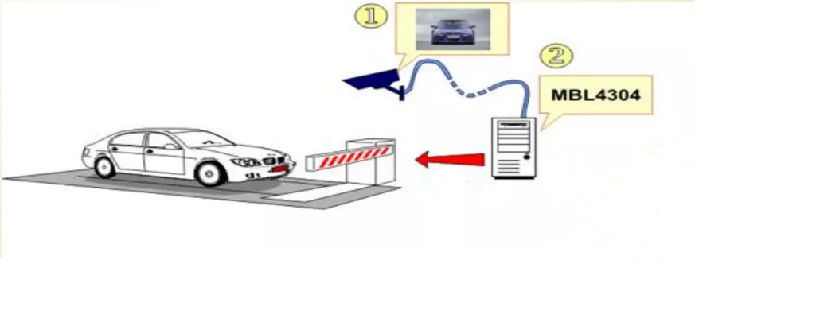
Cont..
1.Image detection
2.Number plate detection

Slide 8
Literature Survey
Journal Title :
Vehicle number plate detection by using python and open cv.
Institute of Electrical and Electronics Engineers(IEEE) ISBN: 978-1-7281-7741-0/21/$31.00,20 April 2021
Source : https://ieeexplore.ieee.org/document/9404556

Slide 9
Cont..
This project presents the design and implementation of a smart vehicle number plate detection.
The implementation is based on digital image processing.
In this project, we have effectively sorted out some way to get the result.

Slide 10
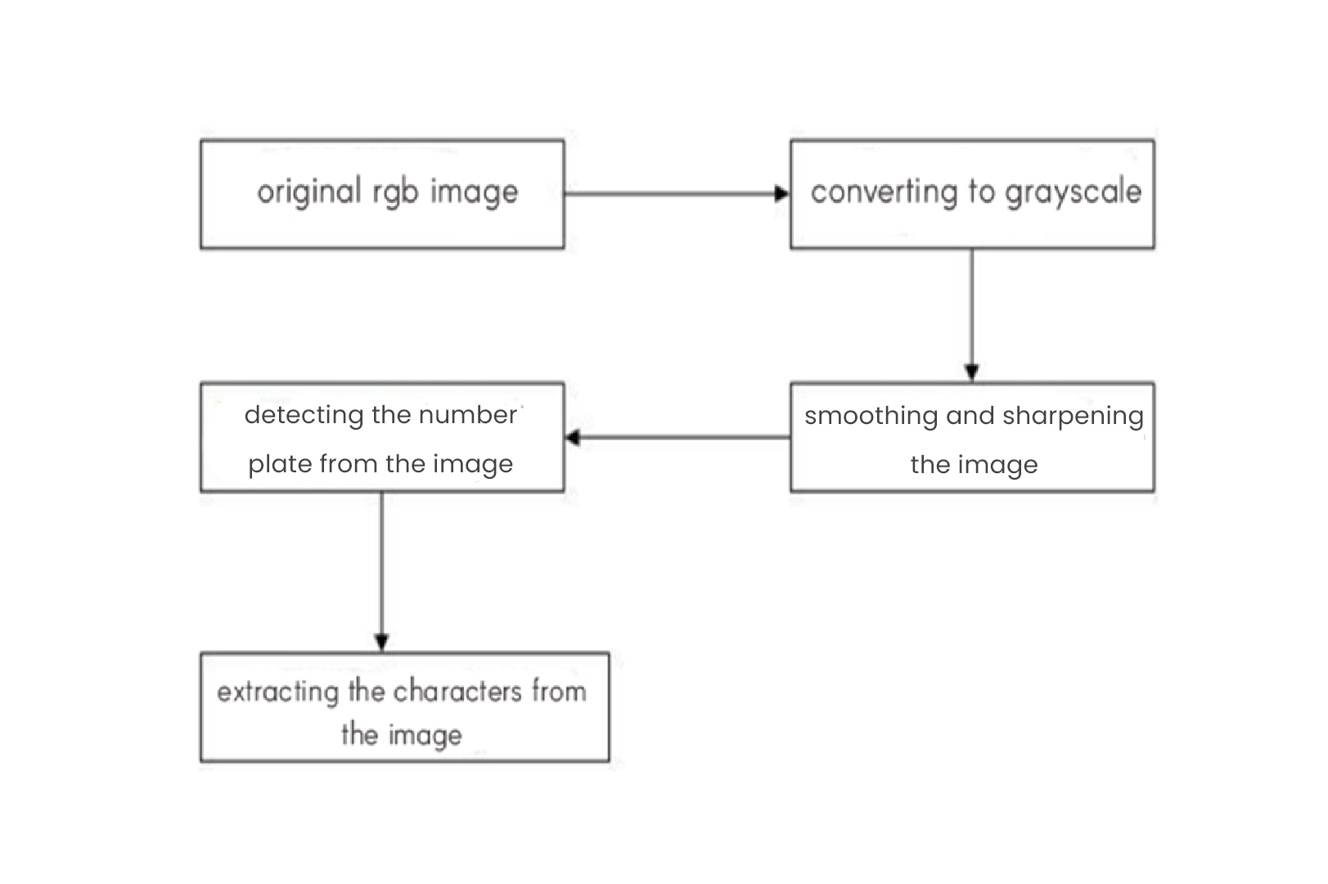
Block Diagram

Slide 11
Methodology
We use the open cv to convert the RGB image to a Grayscale image and its done by taking the average values of each primary elemental color and we get an equivalent grayscale value
Using the OpenCV to identify the objects such as number plate of the vehicle
Using the threshold technique to increase the threshold levels or simply sharpen the image
Using pytesseract
which is an OCR tool in python to extract the characters from the number plate

Slide 12
Procedural Operation
Character recognition
Original RGB image
Using OpenCV for recognition
01
03
05
02
04
Using Threshold technique
GrayScale Conversion

Slide 13
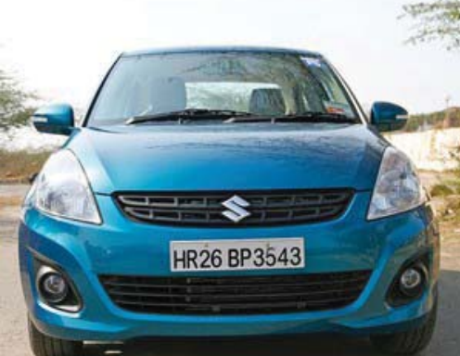
Expected Results
Original RGB image
Here an image that is given as the input

Slide 14
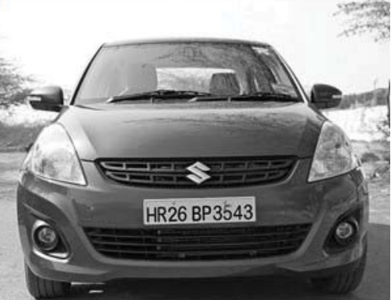
Expected Results
Grayscale conversion
The image given as the input is converted from black and white to gray as shown below

Slide 15
Expected Results
Using OpenCV for number plate detection
Basically, OpenCV is a library that is the Computer Vision, used for object detection and recognition

Slide 16
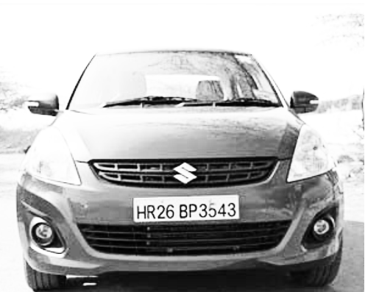
Expected Results
Using threshold technique
After it recognizes the number plate it crops up to the number plate
The next step is enhancing or sharping the image for better character recognition
Before
After

Slide 17

Expected Results
The result of the image after the thresholding technique

Slide 18
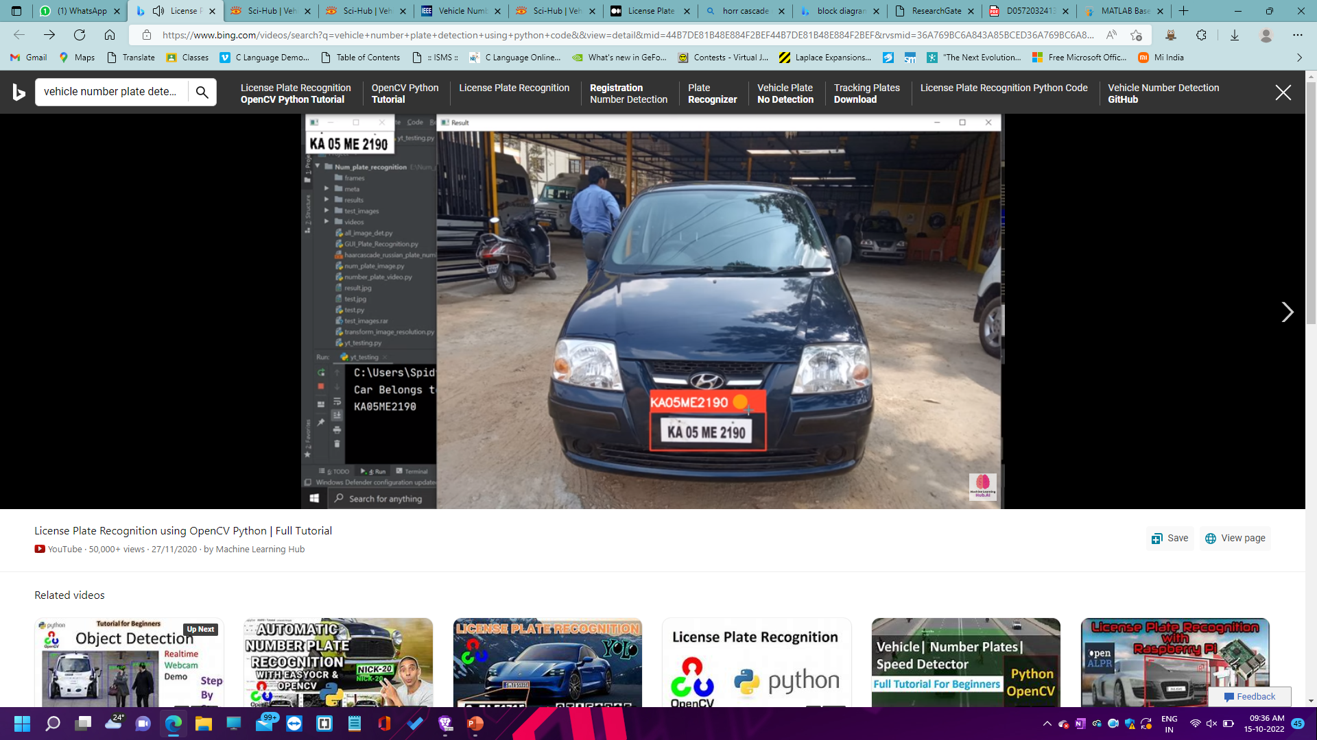
Expected Results
Character recognition
After thresholding, the alphanumeric character is been recognized

Slide 19
Advantages
Python is a free and open-source programming language whereas MATLAB is not a free and closed source.
In python it provides a dedicated library for image processing whereas MATLAB provides a generic for all libraries. In python, there are a huge number of libraries available in python consisting of algorithms used to detect objects.
When using contours methods it processes the whole image by edge detection with the help of contours detecting of the number plate after that we extract the text from the number plate but whereas in harrcascade it detects the number plate which makes it easier to extrtact the contents from the plate than contours

Slide 20
Applications
Identification of stolen cars and bikes.
Help police or security agency to scan and identify unknown and invalid license plate vehicles.
Parking service companies can better monitor entry and exit.
Secure border crossing by assessing if a car is suspicious.
Monitor traffic in prohibited areas ,no parking service.

Slide 21
Conclusions
In this project, we made a software which detect the vehicle number plate number using open cv and image processing.
It will determine the number plate of vehicles.
Though we have tried to make efficient software but there are some condition for this software to work:-
Vehicle number plate should be white and according to rule given by government of India.
Image should be clean and clear.

Slide 22
Future scope
The project currently works over still captured images only and can be modified in future to be implemented to extract license plate information over live video feeds.
Efficiency of the project can be increased by improving the character segmentation algorithm so it can be applicable to various types of car's images.
Image Processing speed can be increased by installing faster processors.
We are currently using pre build computer vision library for recognizing and detecting license plate numbers.
This can further enhance the speed and process for images.

Slide 23

References
https://ieeexplore.ieee.org/document/9404556
https://www.researchgate.net/publication/349939759_Automatic_number_plate_recognition_using_deep_learning
https://www.researchgate.net/publication/349939759_Automatic_number_plate_recognition_using_deep_learning
ANPR system – ijert.org
https://ieeehttps://ieeexplore.ieee.org/document/8447966xplore.ieee.org/document/8447966

Slide 24
Progress
This week we explore to gather necessary libraries requied to implement the project.
Try to implement some subblocks in the project and rectification of errors to get the expected results.
This week the project is done up to the number plate detection.

Slide 25
THANK YOU

